Slide 1


How to live in the Data-Science bubble?
Balaji Sundaresan - NJ Data Science Meet-up, 07/23/2016
Notes:
So what was the idea that came out of that initial exploration?
Let us take a look!
The idea was to develop a tool that would represent and persist knowledge structures comprised of knowledge states in a graphical datastore. This should also show the hierarchical structure of how the knowledge states are related, preferably by using the labeled edges of the graphs. The repository should be able to
depict the Bayesian Knowledge Tracing probability weights depicted by labels added
to edges.
The tool would also persist the mapping of the learning maps with knowledge states. It should also persist the
mapping of assessment questions with knowledge states.

Slide 2
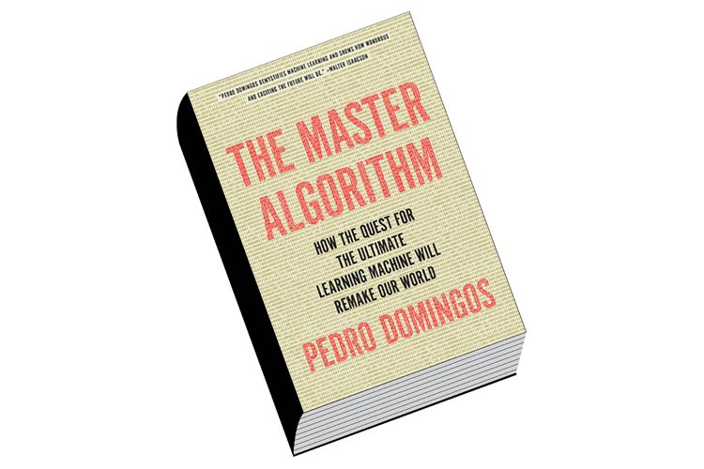
The Master Algorithm by Pedro Domingos
Books !!
Balaji Sundaresan - NJ Data Science Meet-up, 07/23/2016
Notes:
So what was the idea that came out of that initial exploration?
Let us take a look!
The idea was to develop a tool that would represent and persist knowledge structures comprised of knowledge states in a graphical datastore. This should also show the hierarchical structure of how the knowledge states are related, preferably by using the labeled edges of the graphs. The repository should be able to
depict the Bayesian Knowledge Tracing probability weights depicted by labels added
to edges.
The tool would also persist the mapping of the learning maps with knowledge states. It should also persist the
mapping of assessment questions with knowledge states.

Slide 3
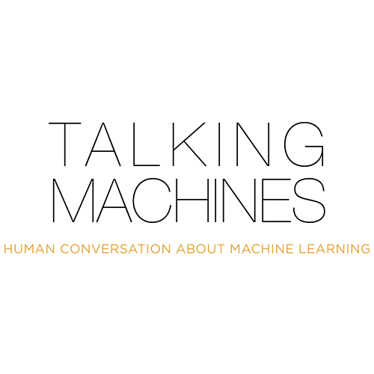
Podcast !
The Taking Machines, hosted by Katherine Gorman and Ryan Adams.
Balaji Sundaresan - NJ Data Science Meet-up, 07/23/2016
Notes:
Let us go through the high level design. The system is comprised of two main subsystems:
The Graphical Persistent Store is a graphical datastore that represents and persists knowledge structures comprised of knowledge states and associated concepts.
The Knowledge Space Framework (KSF) (comprised of the Restful API) is a reusable knowledge space management framework that can be leveraged by ALSs using standardized APIs. It has a standardized Restful API which allows creation, navigation and querying of the knowledge structures.
A web-based Intelligent Tutoring System prototype was also developed to showcase how the KSF APIs can be integrated with an external ALS. It is entirely developed as a client side (browser based) web application.

Slide 4

The Official Blog of Kaggle
Blogs!!
Balaji Sundaresan - NJ Data Science Meet-up, 07/23/2016
Notes:
So what was the idea that came out of that initial exploration?
Let us take a look!
The idea was to develop a tool that would represent and persist knowledge structures comprised of knowledge states in a graphical datastore. This should also show the hierarchical structure of how the knowledge states are related, preferably by using the labeled edges of the graphs. The repository should be able to
depict the Bayesian Knowledge Tracing probability weights depicted by labels added
to edges.
The tool would also persist the mapping of the learning maps with knowledge states. It should also persist the
mapping of assessment questions with knowledge states.

Slide 5
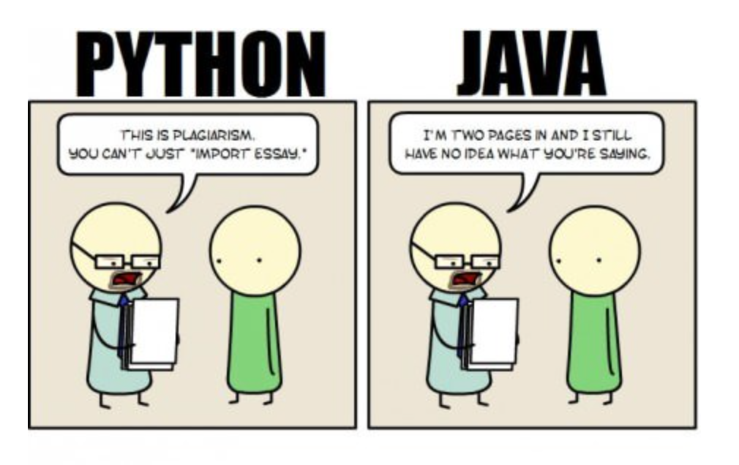
Tools !
Obviously I am biased.
What Is Code? In this article on Bloomberg, Paul Ford gives an insight into the passionate world of Python community.
Balaji Sundaresan - NJ Data Science Meet-up, 07/23/2016
Notes:
Here is a screenshot taken from the skeleton ITS prototype that consumes the KSF framework. The screenshot here shows the full page view of the main screen.

Slide 6

AI is one of the newest disciplines. It was formally initiated in 1956, when the name was coined, although at the point work had been underway for about five years. Along with modern genetics, it is regularly citied as the “field I would like to be in” by scientist in other disciplines. A student in physics might reasonably feel that all good ideas have been taken by Galileo, Newton, Einstein, and the rest, and that it takes many years of study before one can contribute new ideas. AI, on the other hand, still has openings for a full-time Einstein.
- Excerpts from the book Artificial Intelligence: A Modern Approach by Stuart Russell and Peter Norvig
Balaji Sundaresan - NJ Data Science Meet-up, 07/23/2016
Notes:
So what is the future of this framework. What can be developed further on top of this?

